Slide 1



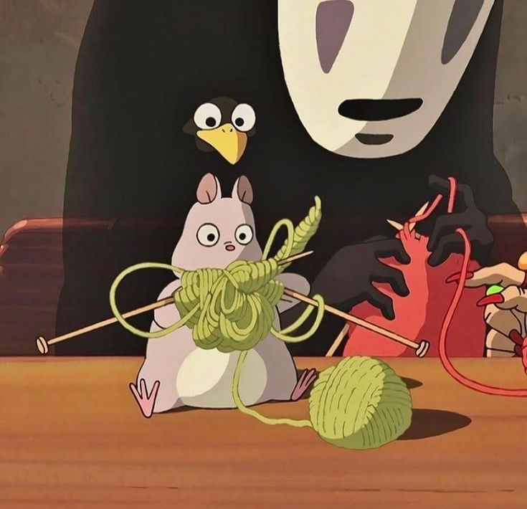

My Portfolio
By- Anshita Mandhana

Slide 2
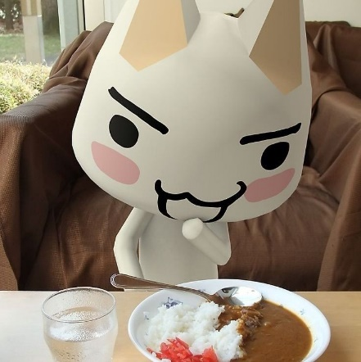
About me (basics)✩°｡ ⋆⸜ 🎧✮
Name – Anshita Mandhana
Age – 17 years ☹
Grade – 12th standard (yes this the last year of prison)
Subjects opted – Accountancy, Business Studies, Economics, English, Web Application.
School – MPS International.
Hobbies – Video games, art, journaling, book reading (espeacially mythology).
Favourite foods – Lasagna, dim sums, dal roti, authentic pizza.
Favourite deserts – Bubble tea, naturals ice cream, sago, gulab jamun.

Slide 3
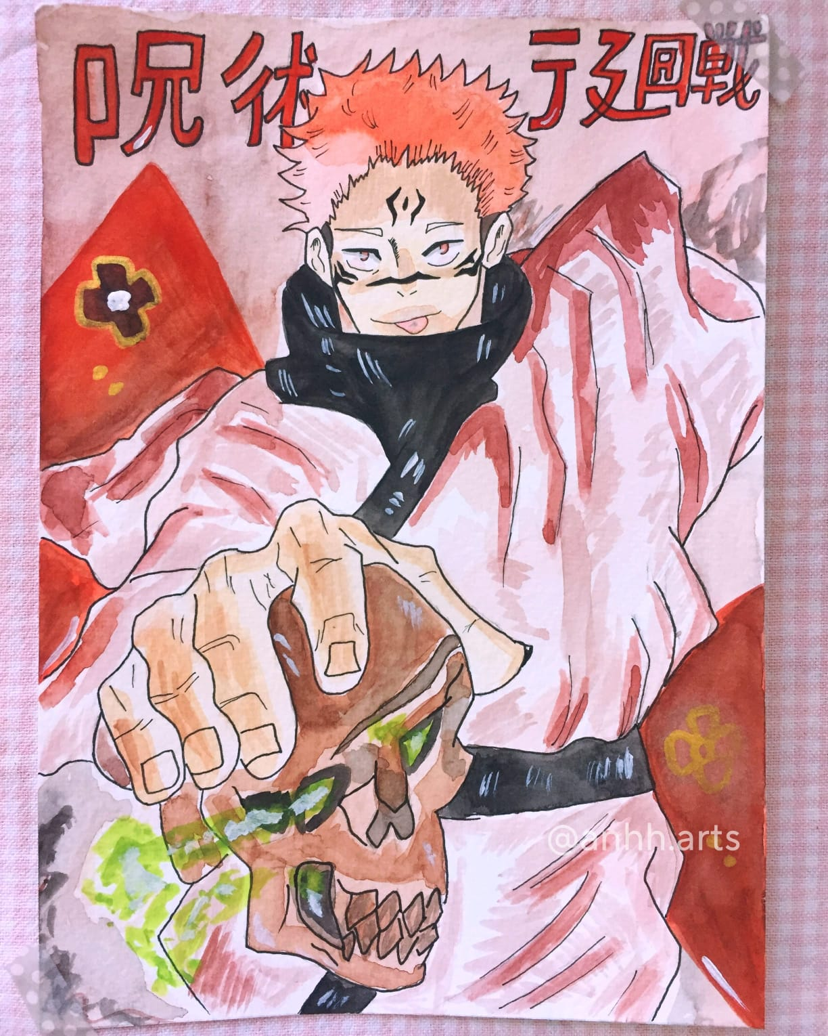
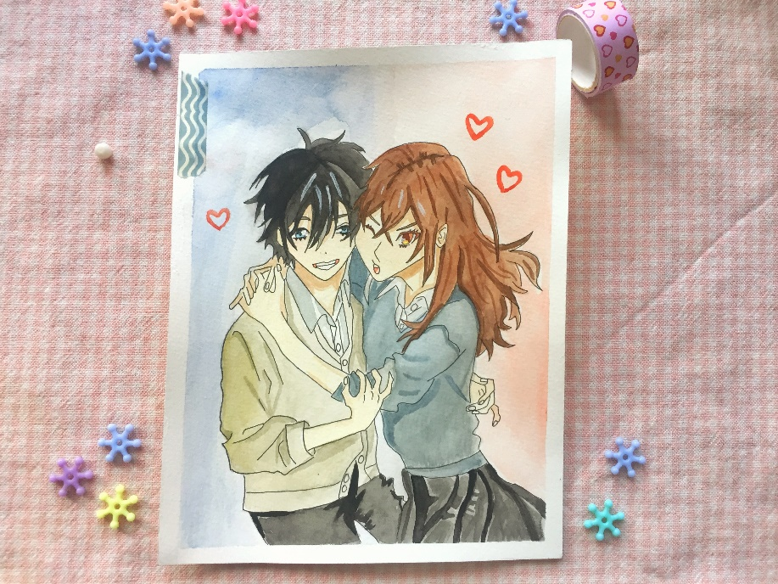
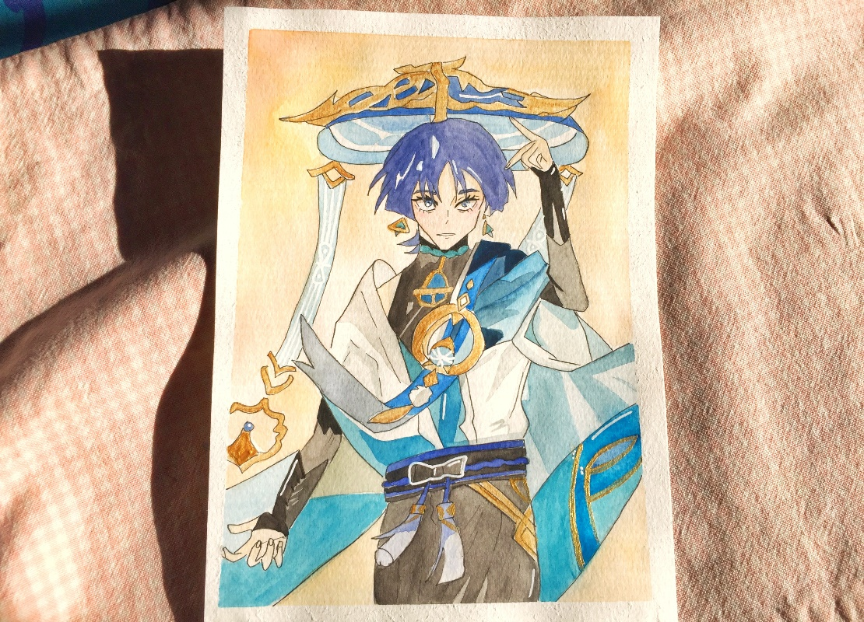
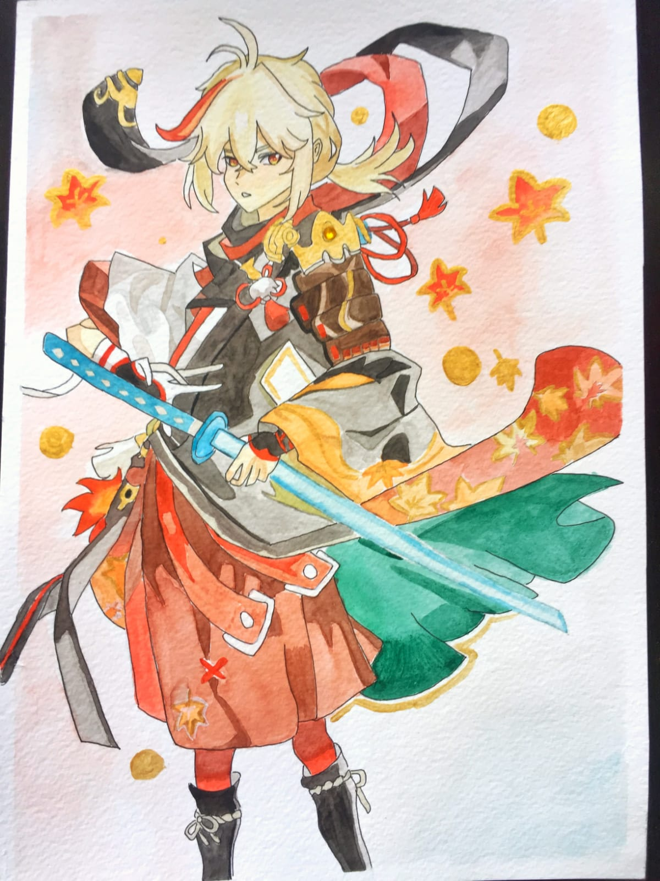
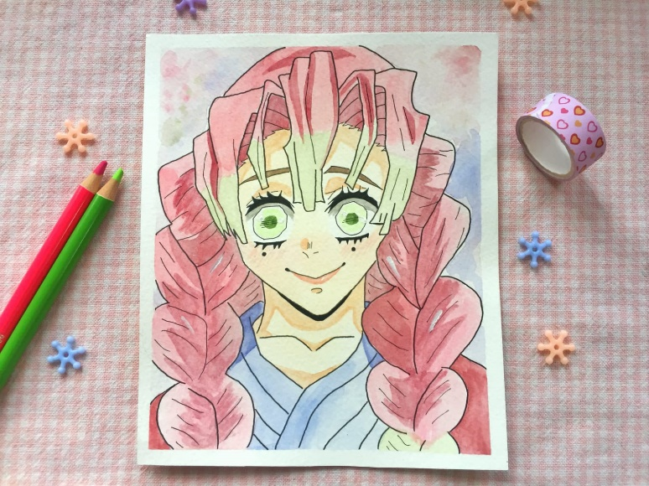
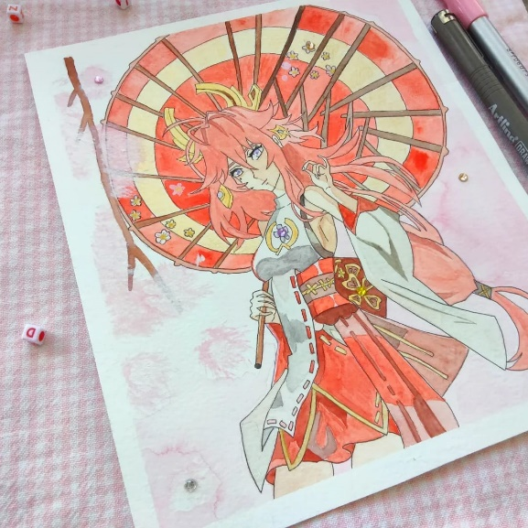
ART ‧₊˚🖇✩ ₊˚🎧⊹♡
Instagram - @anhh.arts

Slide 4
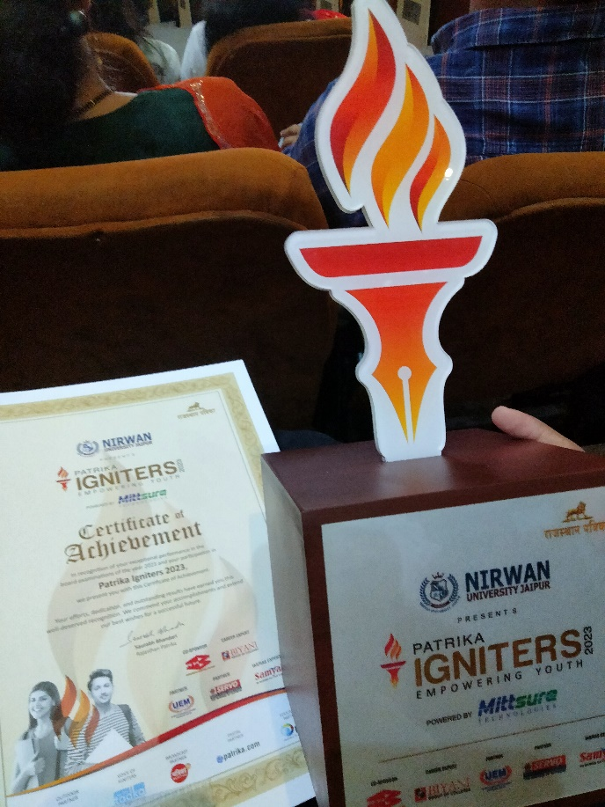
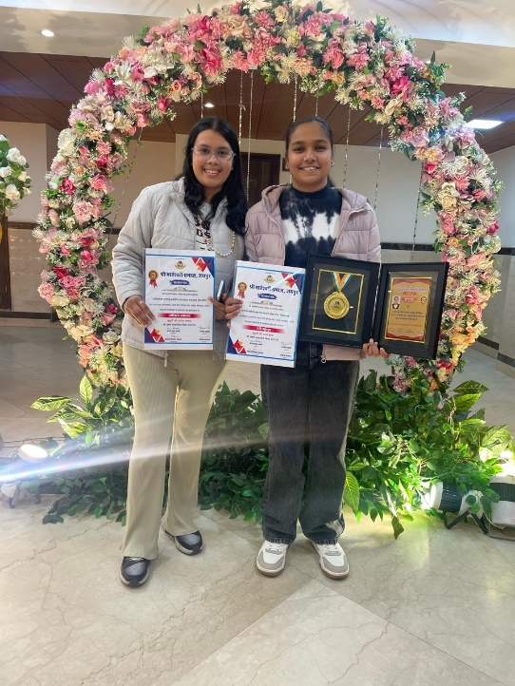
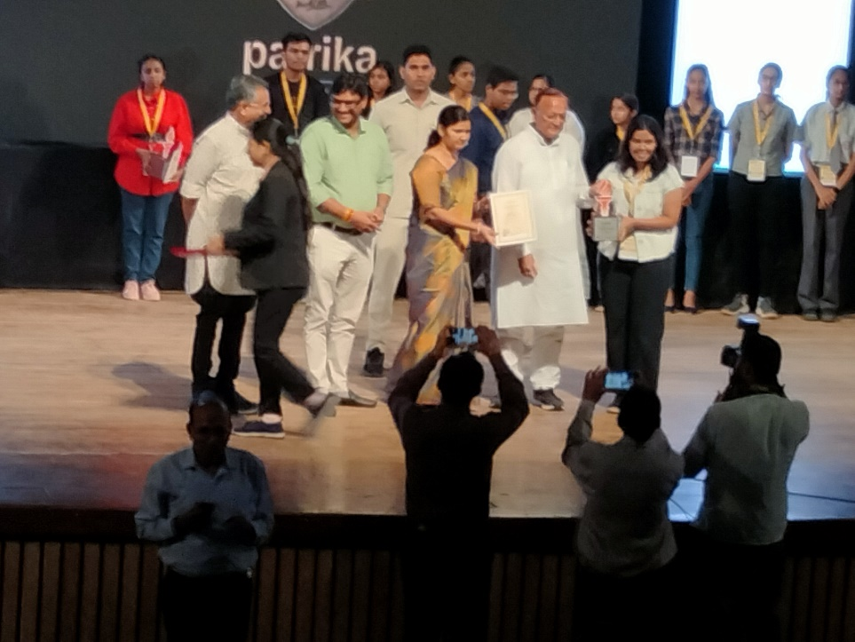
Achievements ๋࣭ ⭑🍓⊹ ๋࣭ ⭑
I have received a number of certificates throughout my school life but I have only mentioned a few in the table futher on the next page which holds much greater significance in my life!!

Slide 5
SERIAL NUMBER | NAME OF ORGANISATION/SCHOOL | AWARD OR CERTIFICATE | CAUSE OF FALICITATION
1. | DAINIK BHASKAR | AWARD | 10TH CLASS PERCENTAGE – 93%
2. | MAHESHWARI SAMAJ | CERTIFICATE (WITH CASH ENVELOPE) | 10TH CLASS PERCENTAGE
3. | VARDHMAN SRIKALYAN INTERNATIONAL SCHOOL | CERTIFICATE | DEBATE COMPETITION
4. | INDIAN DEVELOPMENT FOUNDATION | CERTIFICATE | FOR PARTICIPATION IN RESOURSE MOBILISATION FOR HUMANITARIAN CAUSES
5. | MPS INTERNATIONAL | AWARD | FULL ATTENDANCE

Slide 6
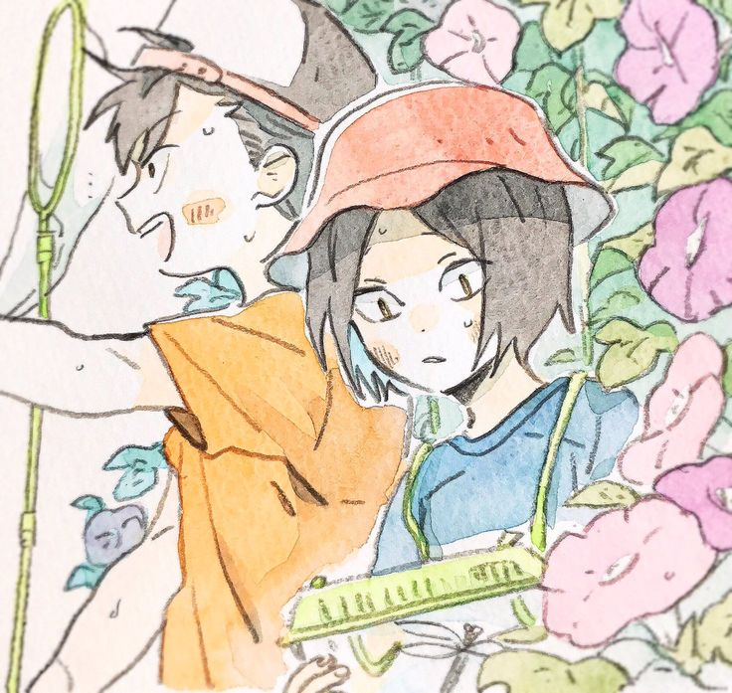


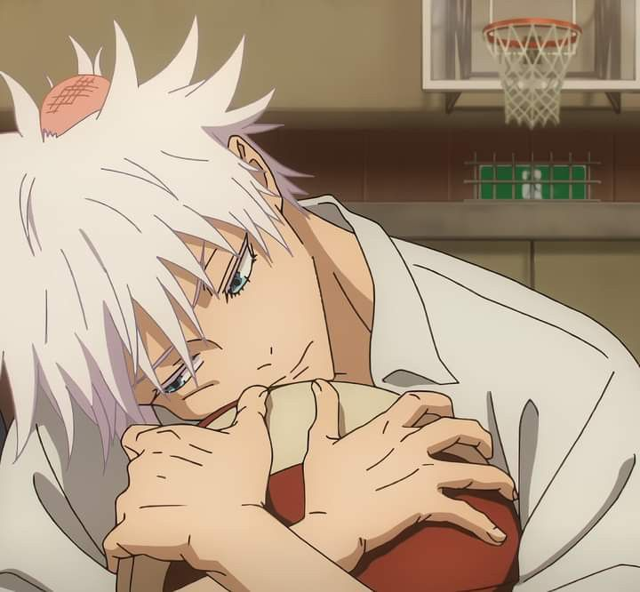

THANK YOU!!

